Slide 1
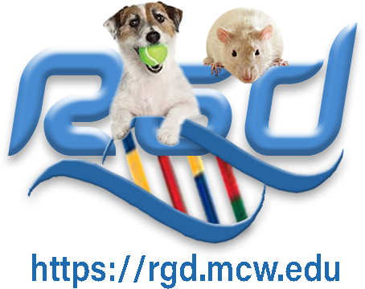
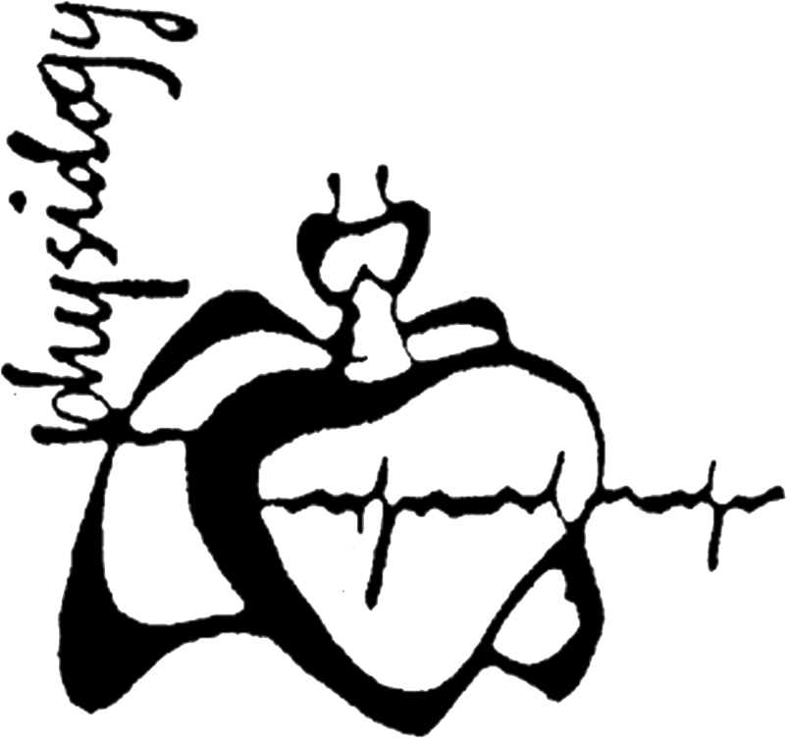


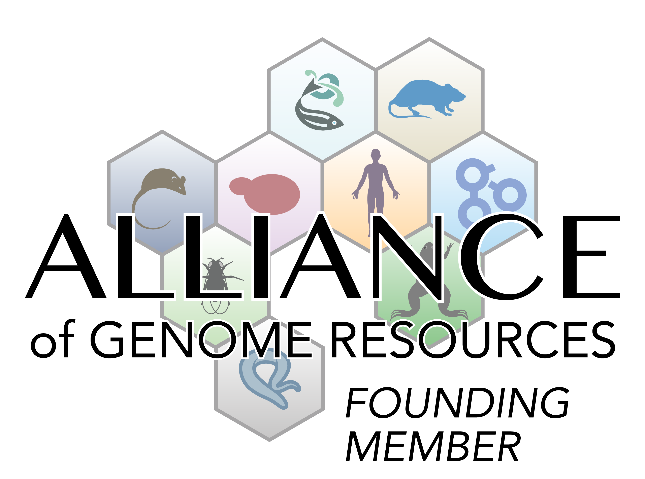

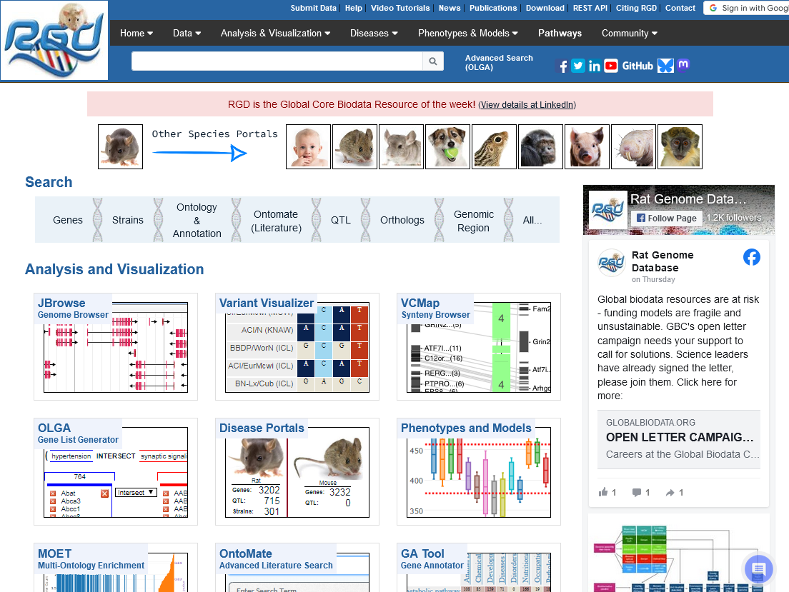
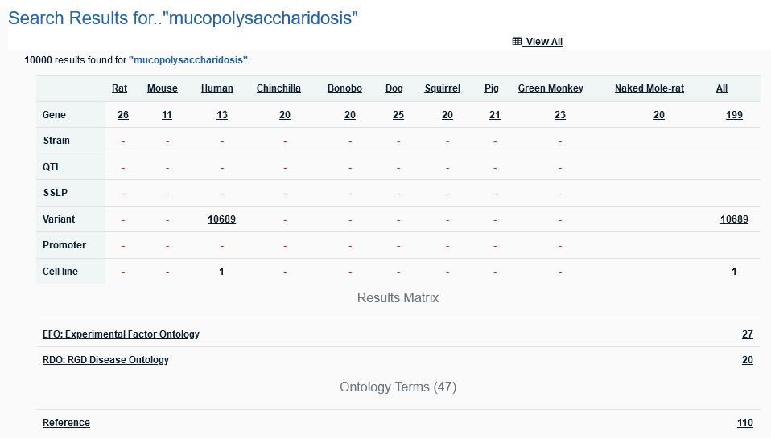
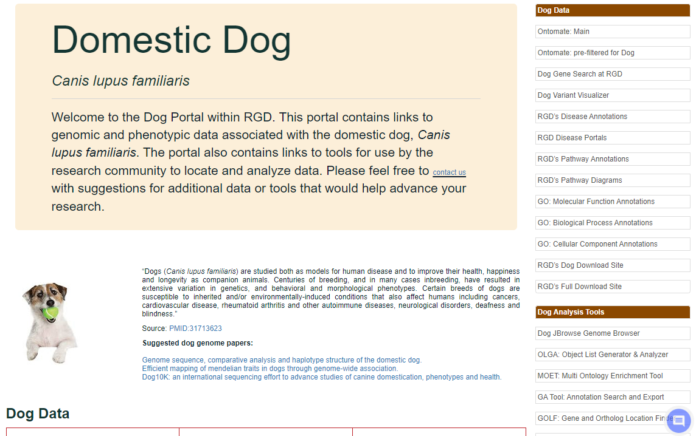
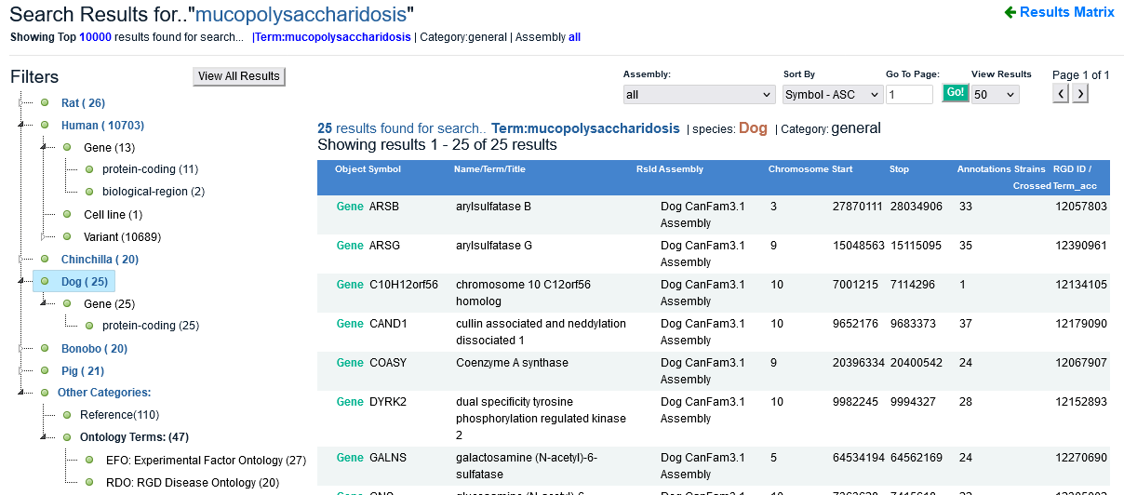
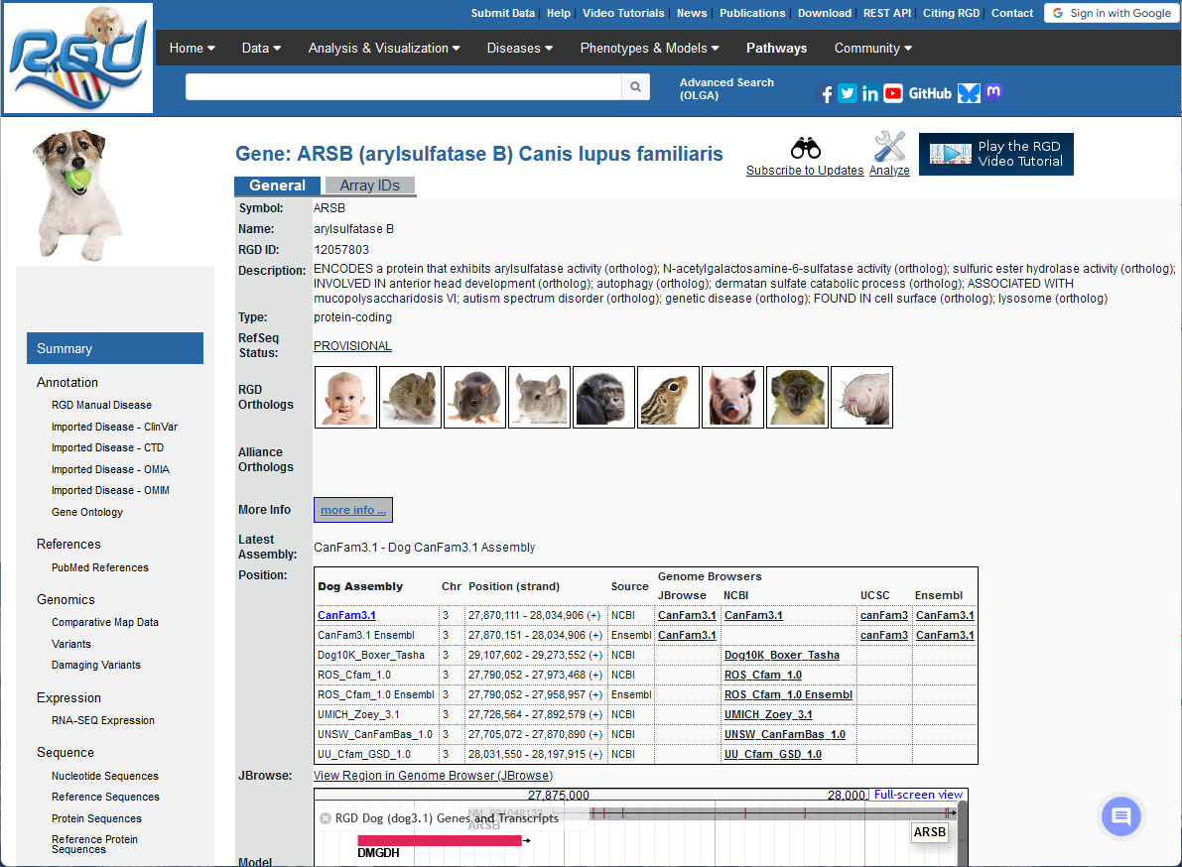
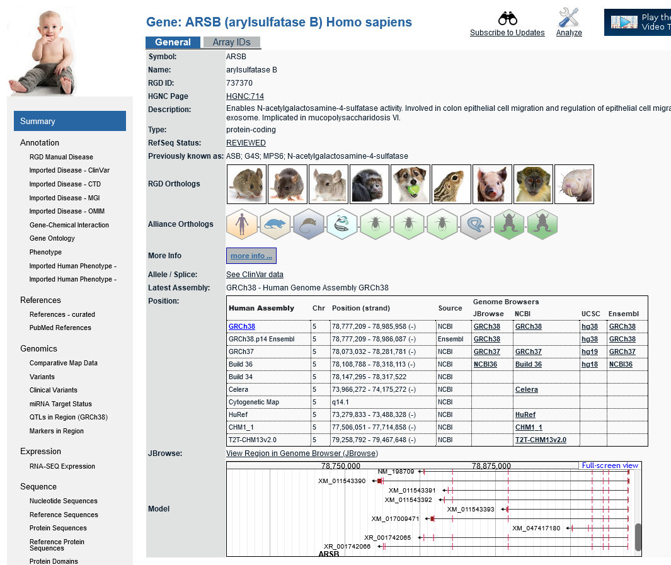
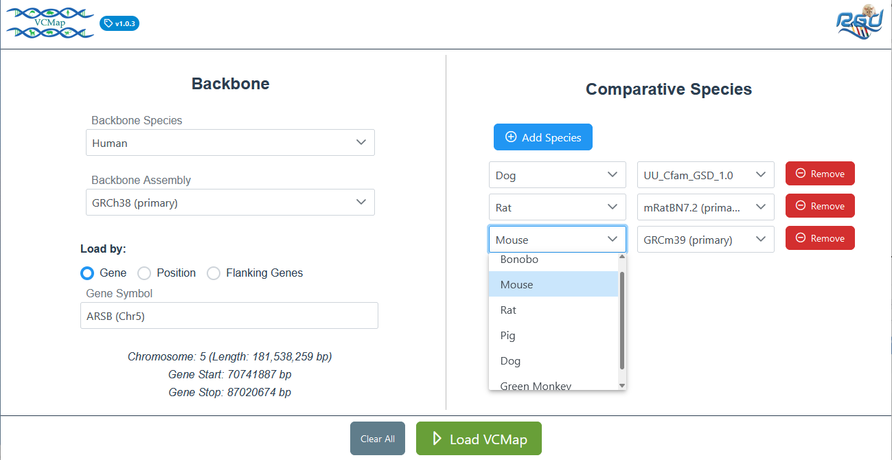
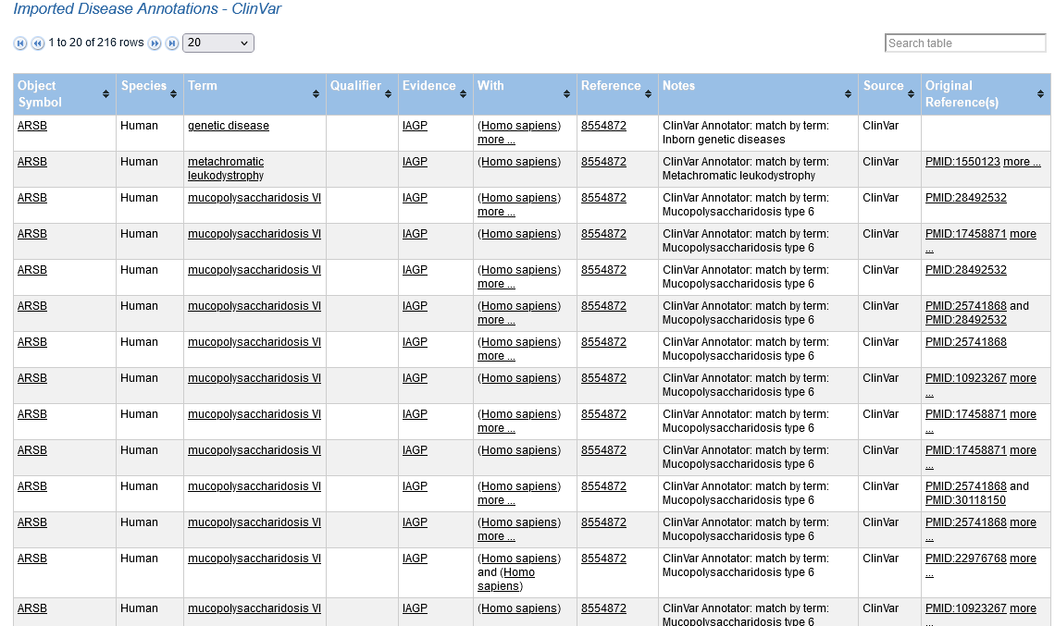
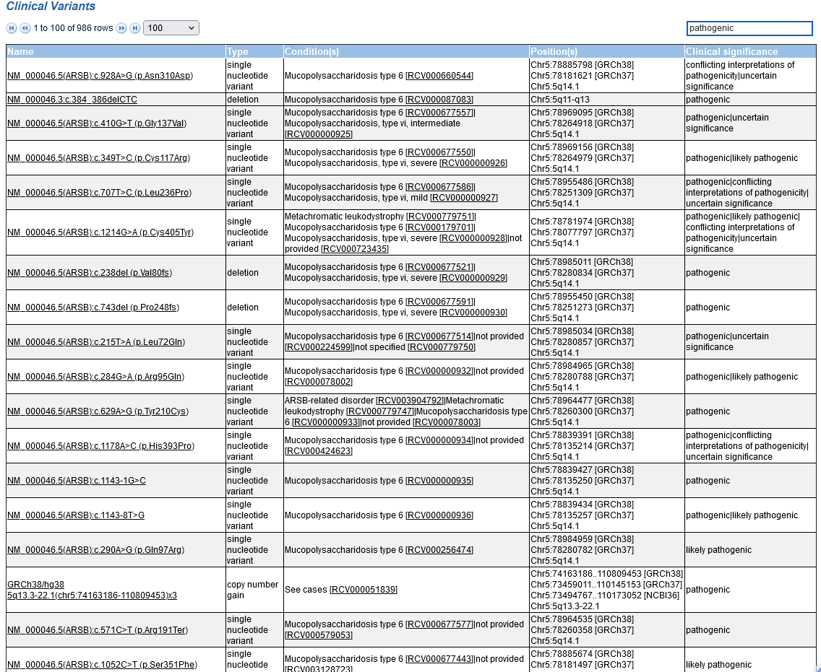
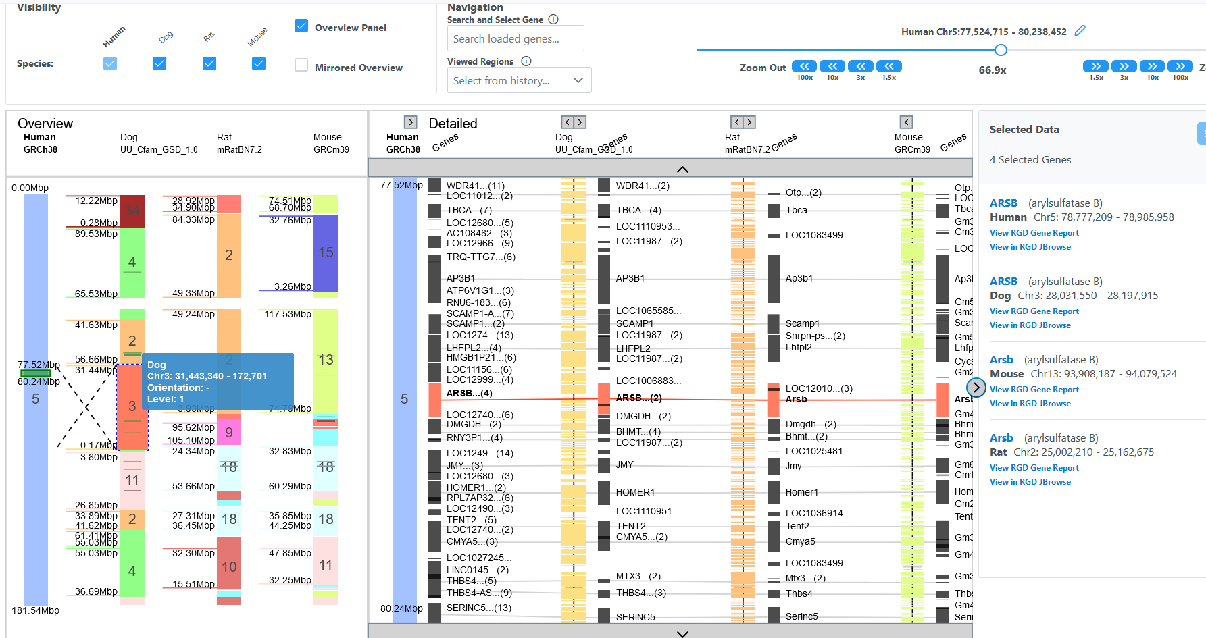
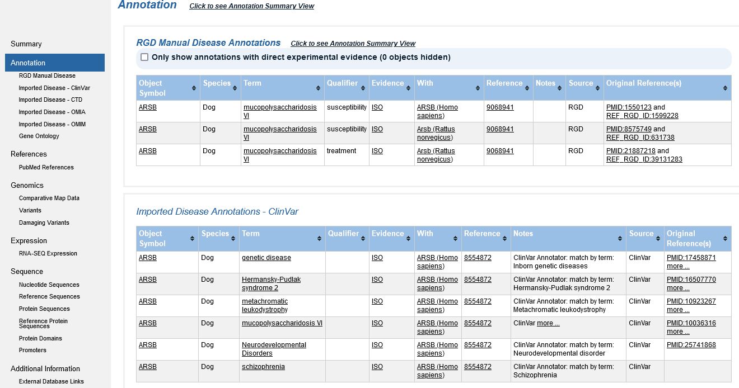
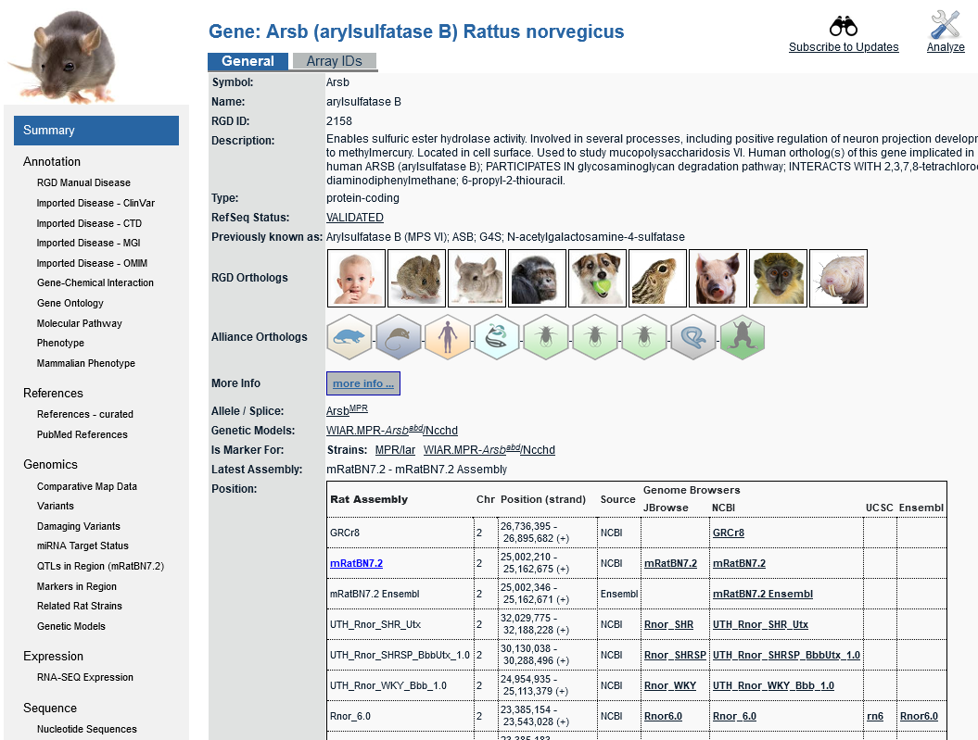
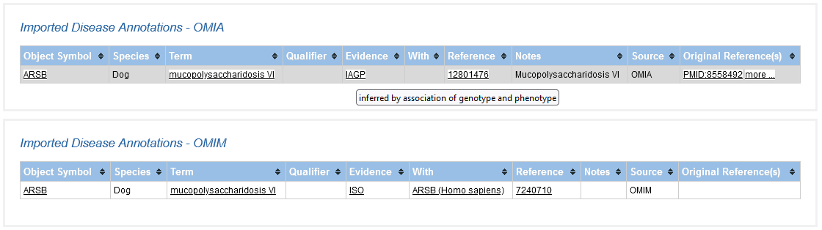
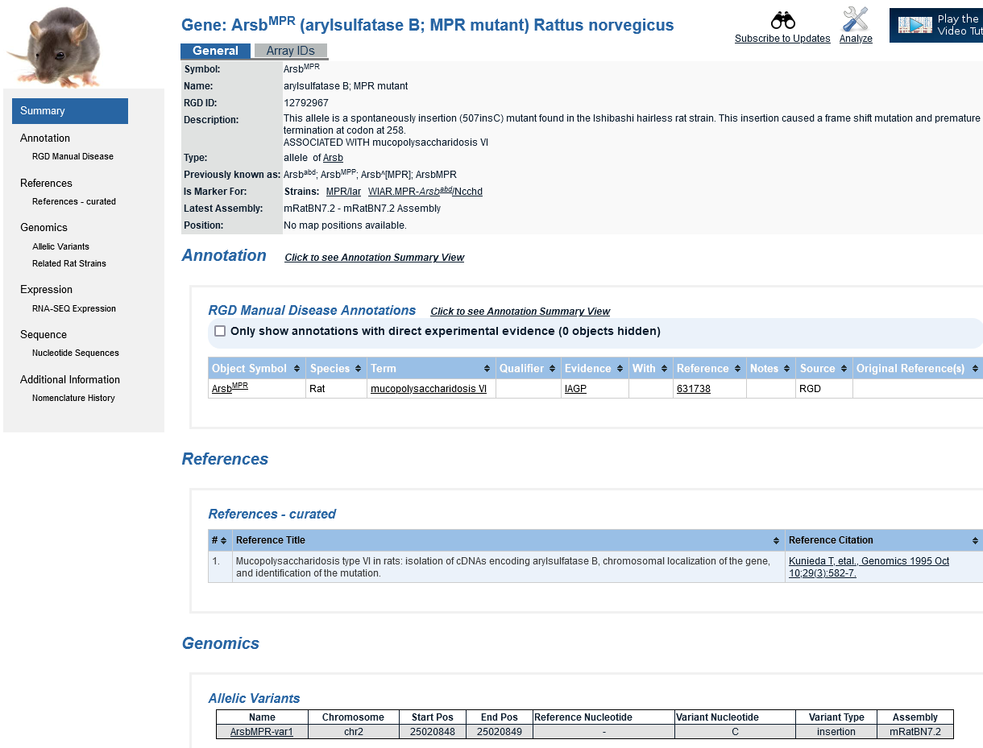
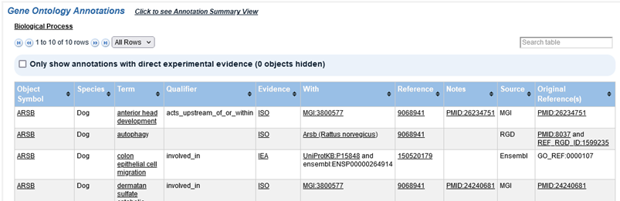
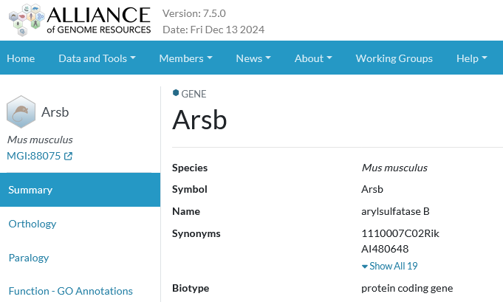
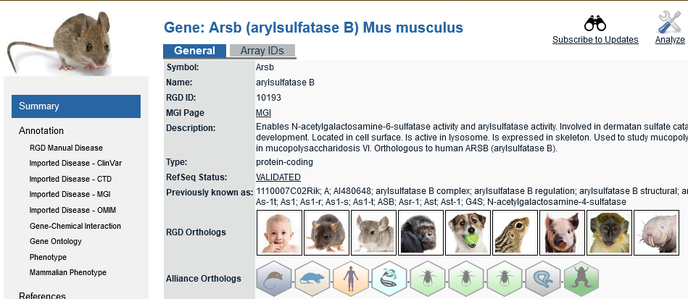
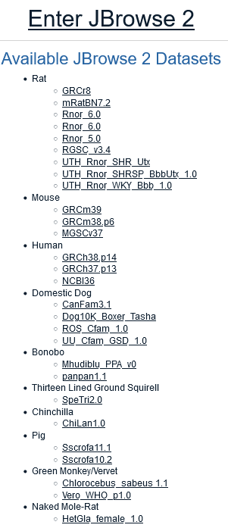
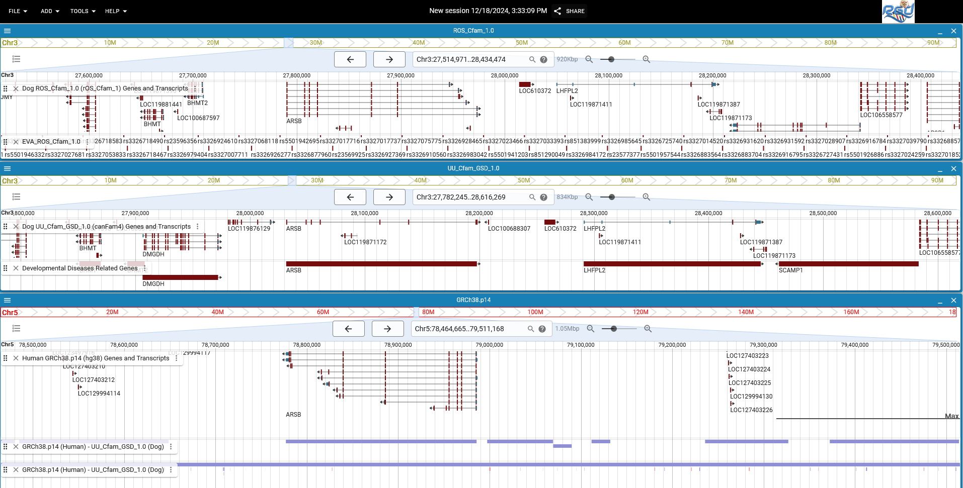
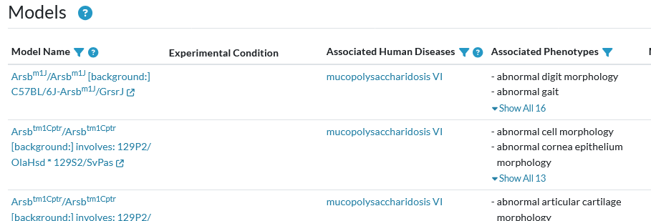
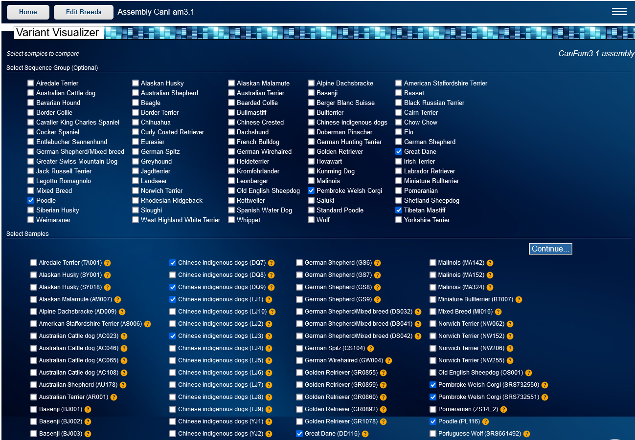
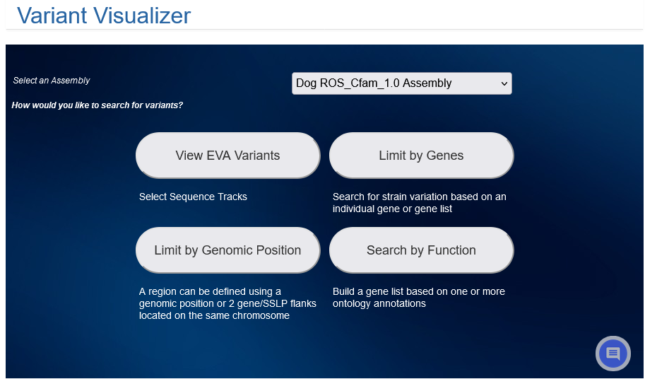
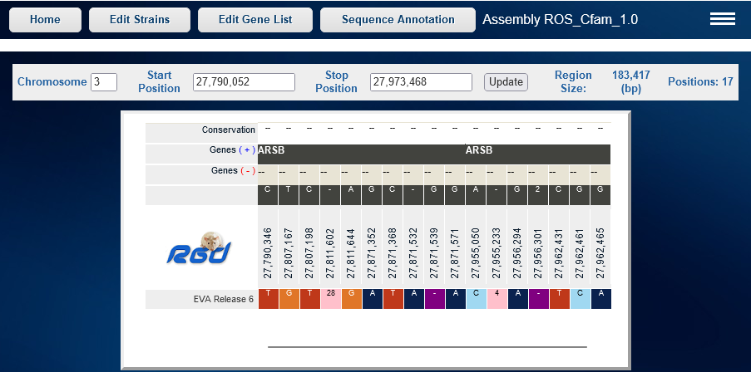
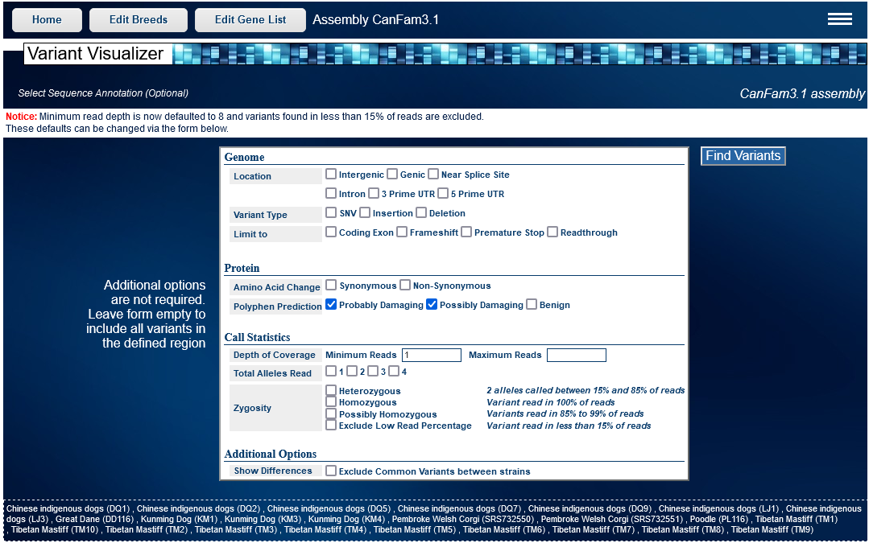
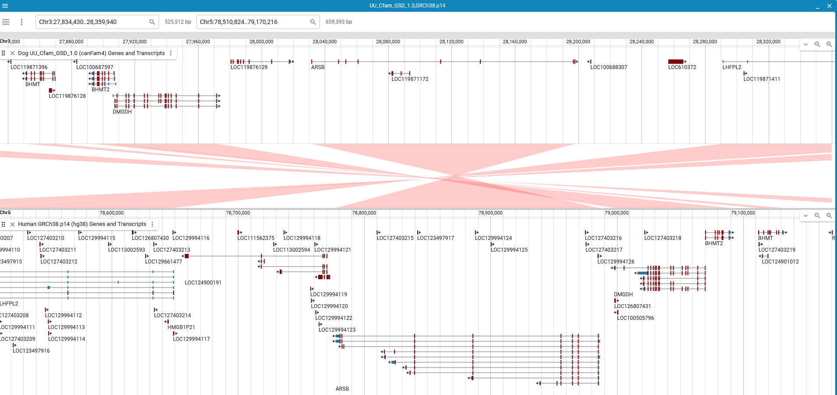
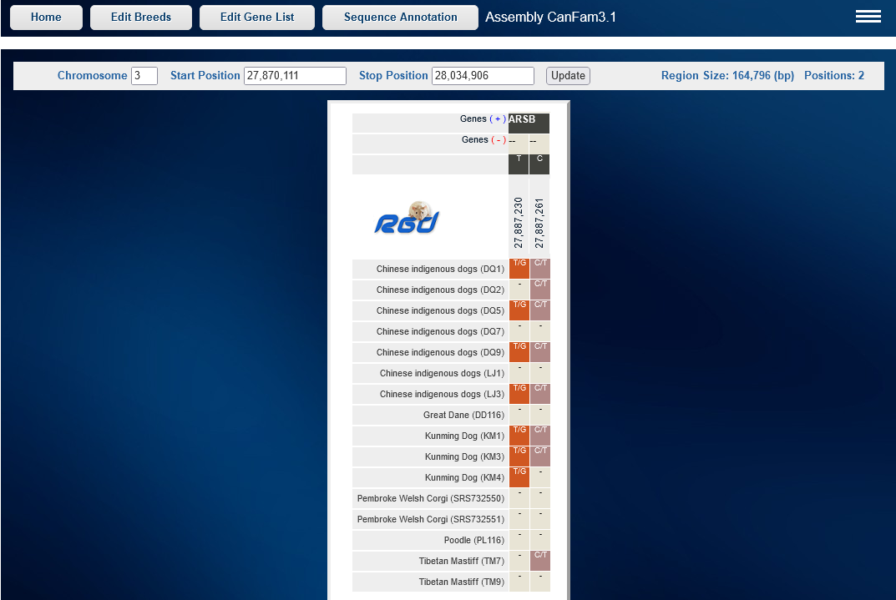
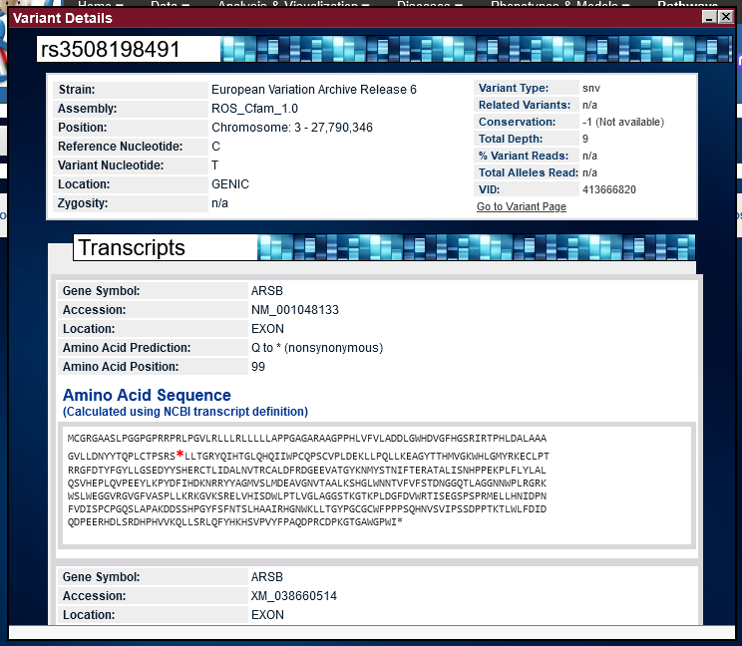
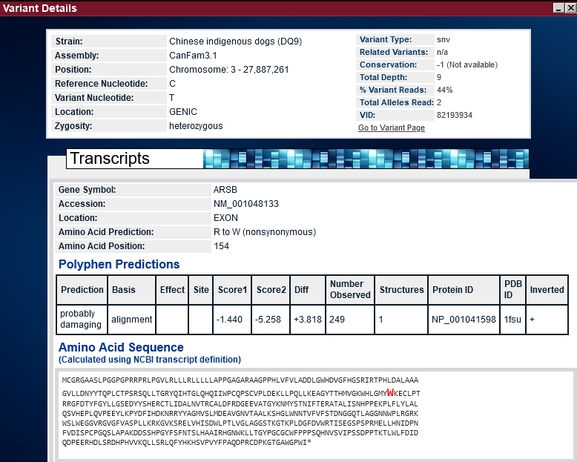
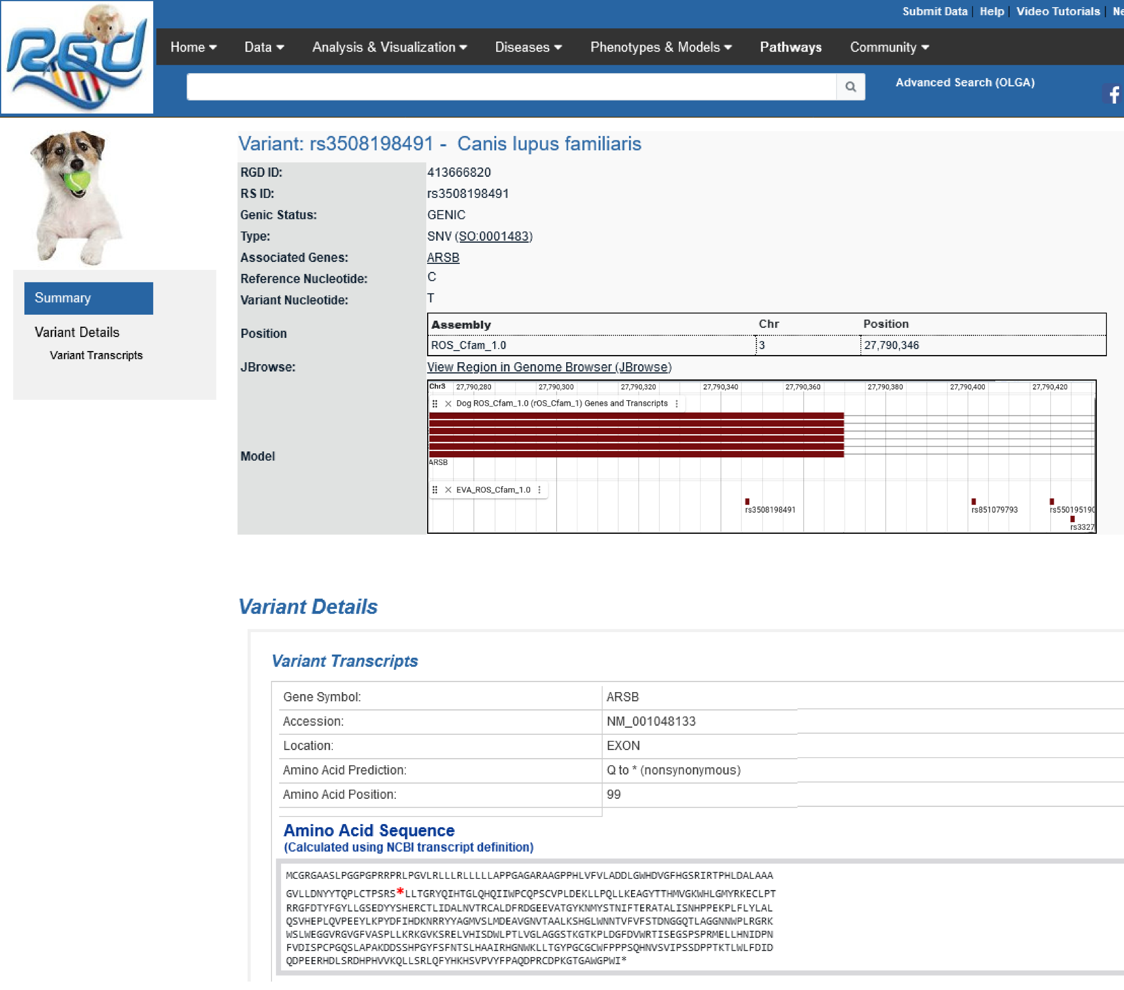
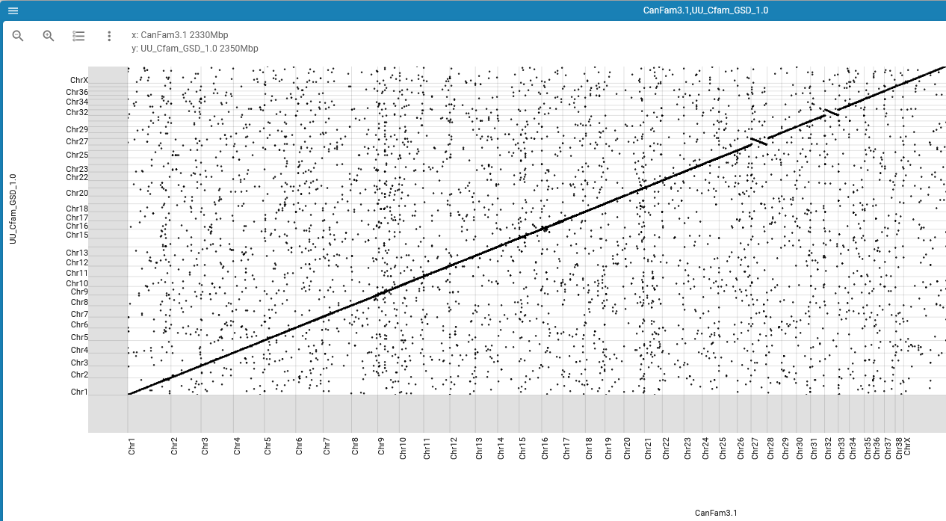
RGD: Functional and Comparative Genomics Resources for Dog
Jennifer R Smith¹, Stanley JF Laulederkind¹, G Thomas Hayman¹, Shur-Jen Wang¹, Monika Tutaj¹, Mary L Kaldunski¹, Mahima Vedi¹, Wendy M Demos¹, Marek A Tutaj¹, Jyothi Thota¹, Logan Lamers¹, Adam C Gibson¹, Akhilanand Kundurthi¹, Varun Reddy Gollapally¹, Kent C Brodie², Stacy Zacher³, Jeffrey L De Pons¹, Melinda R Dwinell¹, Anne E Kwitek¹
¹Rat Genome Database, Department of Physiology, ²Clinical and Translational Science Institute, ³Finance and Administration, Medical College of Wisconsin, Milwaukee, WI, USA.
Abstract:
Poster # P146
Photography permitted. This poster is freely available in the RGD Presentations Archive at https://rgd.mcw.edu/wg/com-menu/poster_archive/
RGD (https://rgd.mcw.edu) is a multispecies knowledgebase integrating data for ten mammalian species: dog, human, rat, mouse, chinchilla, bonobo, pig, 13-lined ground squirrel, green monkey and naked mole-rat. Dog (Canis lupus familiaris) is an important subject of research, both as a model for human disease and in its own right because of its status as a companion and working animal. As such, RGD’s coverage of dog genomic data, and the representation of dog data in RGD’s suite of comparative genomics analysis tools are being expanded. Multiple dog assemblies as well as orthology data between dog and other species are being added to RGD’s JBrowse 2 genome browser to allow direct intra- and inter-species comparisons. RGD’s unique Virtual Comparative Map (VCMap) tool will now provide interactive views of synteny between human and dog, rat, mouse, pig, bonobo and green monkey. The Variant Visualizer tool houses variant data across 75 categories, encompassing purebred, mixed breed and wolf samples from the Dog 1000 Genomes Project, as well as consolidated data from the European Variation Archive (EVA). Functional information contained in Disease, Pathway and Gene Ontology annotations to genes are provided. Some annotations are derived from dog-specific curation, for example from the Online Mendelian Inheritance in Animals database. A substantial number of annotations are assigned based on orthology between dog genes and those in other species, leveraging the rich resource of human, rat and other species' data available at RGD. In the future, RGD would like to partner with researchers who could submit functional, disease, phenotype, and/or variant data to the database to further enhance the resource both for dog researchers and for those interested in comparative and translational studies.
RGD has multiple tools for searching and data mining but the simplest and most comprehensive is the general search at the top of most pages. Enter a gene symbol or name, or a keyword such as a disease name. As shown here, search results for all RGD species and datatypes are summarized in the results matrix.
mucopolysaccharidosis
RGD's Dog Species page provides easy access to dog-centric data and analysis tools. The page also links to external resources for dog researchers and a selection of a few of the key dog research articles.
Choose a specific datatype and/or species to see targeted results or select "View all" to see a detailed list of all results.
Gene Report Pages
The Virtual Comparative Map (VCMap)
Each gene page provides links to orthologous genes in the other RGD species. Here the gene pages for human, rat and mouse arylsulfatase B genes are shown. Where there are experimental annotations for disease, pathway, and/or gene ontology in one species, analogous annotations are assigned to genes in other species based on orthology. These ortholog-based annotations are
The Virtual Comparative Map (VCMap) provides functionality to view synteny across multiple species. Choose a backbone species and assembly, a genomic region and one or more comparator species. Here selections have been made to view the region around the ARSB gene in human, dog, rat and mouse. Data for pig, bonobo and green monkey are also available.
based annotations are not proof of an association in that species but are meant to serve as pointers.
The Overview panel shows the syntenic regions in dog, rat and mouse that correspond to regions on human chromosome 5. Mousing over the synteny block containing ARSB shows that the regions are reversed between dog and human. In the Detail panel, a red line connects the orthologs in the four species. Selecting one of the genes brings up information about the four orthologs in the side panel to the right.
Variations in arylsulfatase B are associated with
with mucopolysaccharidosis in multiple species. RGD provides clinical variant data from the ClinVar database for human, an annotation for dog from OMIA based on breed variations, and data from both naturally occurring rat strains and genetically modified rats and mice with phenotypic similarities to the disease.
JBrowse 2 Genome Browser
right. Links are provided to the RGD gene report pages and JBrowse 2 for a more detailed view.
Additional mouse data is available via links to MGI and the Alliance of Genome Resources.
JBrowse 2 is an advanced genome browser designed to facilitate comparisons across species and across assemblies for a single species. For example, stacked linear genome views allow both intra-species and inter-species comparisons within a single window.
In addition to disease and gene ontology annotations derived from other species, RGD provides OMIA annotations for dog disease and phenotypes where available. In the case of ARSB, OMIA:000666 reports naturally occurring variants in several breeds associated with mucopolysaccharidosis.
Dog ROS_Cfam_1.0 assembly
Variant Visualizer
Dog UU_Cfam_GSD_1.0 assembly
RGD provides variant data mapped to the CanFam 3.1 assembly for individual breeds from the Dog 1000 genomes project. In addition, consolidated variant data from the European Variation Archive (EVA) is available for both the CanFam 3.1 and the more recent ROS_Cfam_1.0 assembly.
For the ROS_Cfam_1.0 assembly, RGD has imported the variants from EVA Release 6. Here the nonsynonymous variants in the ARSB gene are shown.
Human GRCh38 assembly
Dog orthologs for human genes
Human-to-dog synteny
For variants mapped to the CanFam3.1 assembly, choose a breed group or individual samples within a breed and enter a genomic region or a list of
The variant at Chr3:27790346 in the ROS_Cfam_1.0 assembly is the Q99* stop-gained variant reported by OMIA as associated with mucopolysaccharidosis in Great Dane. Information at EVA confirms that the variant was submitted by OMIA.
The linear synteny view allows direct comparisons of syntenic regions between two species. The shaded areas in the middle of the view show the links between orthologs in the syntenic regions. Here it is clear that the regions are reversed. In the synteny view, any or all of the available tracks for both species can be displayed allowing comparisons, not only of the genes in a region but variants, markers, RNA-Seq alignment data, etc.
The dot plot view shows the results of a whole genome alignment. Here alignment of the CanFam3.1 assembly with the newer UU_Cfam_GSD_1.0 assembly shows good correspondence between the two with the exception of chromosomes 27 and 32.
region or a list of genes. View all matching variants or filter the results by variant type or damage predictions from Polyphen. Shown here are two variants in the ARSB gene in several breeds that are predicted to be either possibly or probably damaging.
If you are interested in submitting functional, disease, phenotype, and/or variant data to RGD to further enhance the resource both for dog researchers and for those interested in comparative and translational studies, we want to partner with you!
RGD is funded by the National Heart, Lung, and Blood Institute (NHLBI; R01HL064541), and the National Human Genome Research Institute (NHGRI) as part of the Alliance of Genome Resources (U24HG010859).

